Slide 1

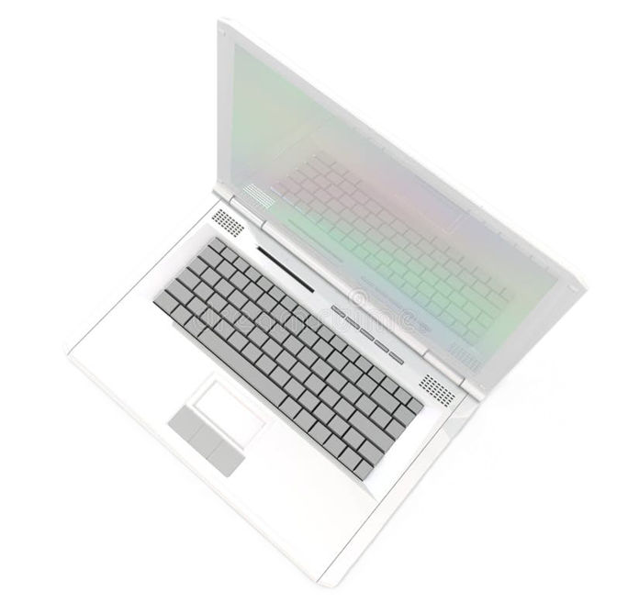
Email and Roster Manager
A google Scripts Web App Created by Shelby Womack

Slide 2
About Me
My name is Shelby Womack
Husband and father of Three
Obsessed with automation and ice cream

Slide 3
Project Introduction
Web Application
Google Apps Scripts
Fetches and Parses emails
Writes relevant data into user-chosen Google Spreadsheets

Slide 4
How it works
Google Cloud Console
Authentication
Gmail API
Parsing
Processing
Integration
Automation
Error Handling

Slide 5
Looking Toward the future
Additional Features
Customization
Real Time Analytics
Scalability
Public Release

Slide 6
What I learned
Google Cloud Console efficiency
Deeper understanding of APIs
Use of Oauth2
Use of Scopes
Use of keys and secrets
Publishing an App on Google

Slide 7
Resources
Google Scripts Documentation: https://developers.google.com/apps-script
Stack Overflow: https://stackoverflow.com/questions/11485271/google-oauth-2-authorization-error-redirect-uri-mismatch
Gmail API Documentation: https://developers.google.com/gmail/api/guides
Google Sheets Docs: https://developers.google.com/sheets/api/guides/concepts
Google Workspace Docs: https://developers.google.com/workspace
Google Drive API Docs: https://developers.google.com/drive/api/guides/about-sdk

